Slide 1
Jenkins
ow

Slide 2
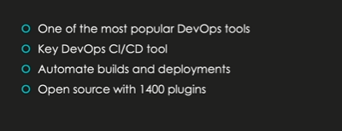
Jenkins Intro

Slide 3
What is Jenkins?
Jenkins is an opensource continuous integration (CI) and Continous delivery (CD) tool written Java
It is a automation server used to build and delivery software projects
Jenkins was forked from other project called Hudson
A major benefit using Jenkins, that it has lot of plugins
Other Alternate solution for CI is also available, since Jenkins is opensource and widely accepted product in the industry.

Slide 4
What is CI/CD?
Continuous Integration(CI) is a DevOps software development practice where developers regularly merge their code changes in the central repository, after which automated build and run test. CI most often refers to build or integration stage of software and run the unit tests on the new code changes immediately surface any errors
Continuous Delivery (CD) is a software engineering approach in which teams produce software in short cycles, ensuring that the software can be reliably released at any time

Slide 5
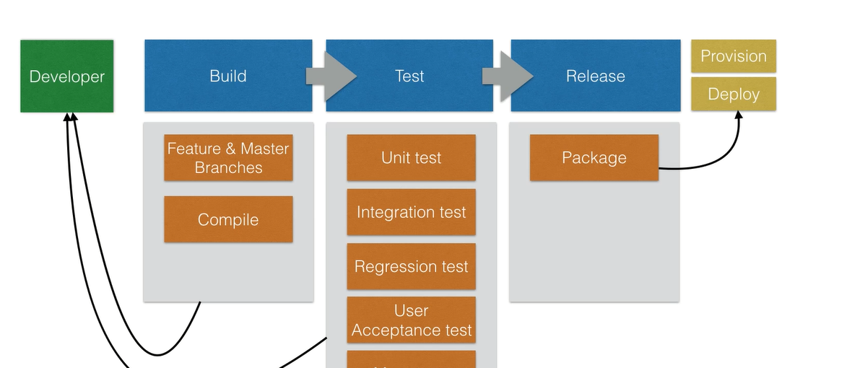
SDLC

Slide 6
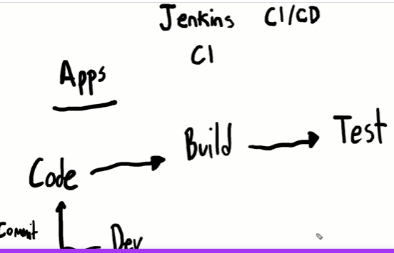
CI

Slide 7
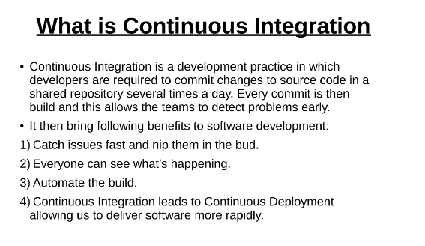
..

Slide 8
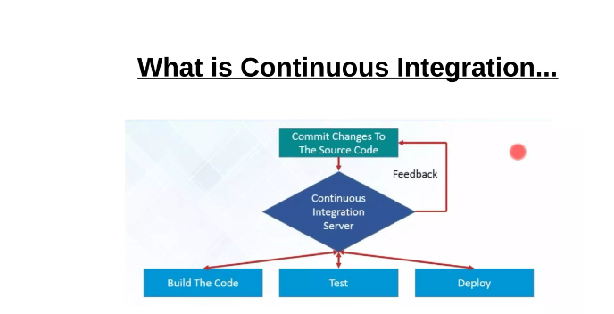
..

Slide 9
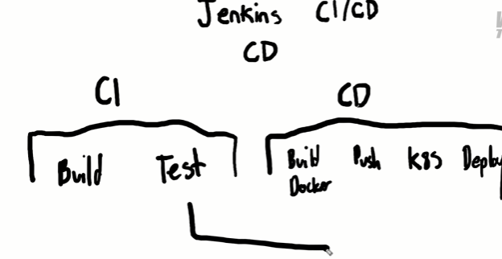
CD

Slide 10
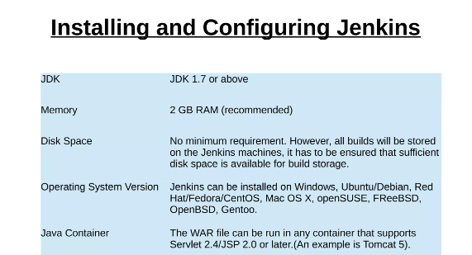
Prerequities

Slide 11
Install Jenkins
On ubuntu/Debian
curl -fsSL https://pkg.jenkins.io/debian-stable/jenkins.io.key | sudo tee \
/usr/share/keyrings/jenkins-keyring.asc > /dev/null
echo deb [signed-by=/usr/share/keyrings/jenkins-keyring.asc] \
https://pkg.jenkins.io/debian-stable binary/ | sudo tee \
/etc/apt/sources.list.d/jenkins.list > /dev/null
sudo apt-get update
sudo apt-get install Jenkins
Using docker https://www.jenkins.io/doc/book/installing/docker/

Slide 12
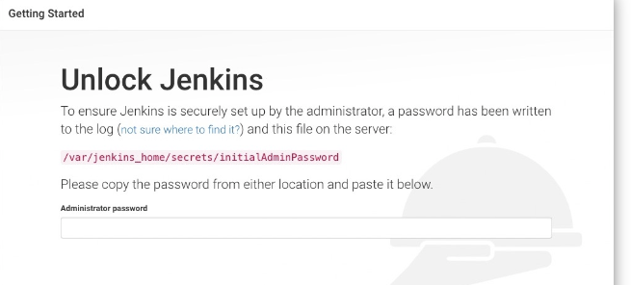
Unlocking Jenkins
When you first access a new instance, you asked to unlock it using an automatically-generated password
Browse to http://<ip address of Jenkins vm>:8080 and wait until Unlock Jenkins page appear

Slide 13
Unlock Jenkins
The command: sudo cat /var/lib/jenkins/secrets/initialAdminPassword will print the password at console.
If you are running Jenkins in Docker using the official jenkins/jenkins image you can use sudo docker exec ${CONTAINER_ID or CONTAINER_NAME} cat /var/jenkins_home/secrets/initialAdminPassword to print the password in the console without having to exec into the container.
On the Unlock Jenkins page, paste this password into the Administrator password field and click Continue.

